Slide 1
Presentation 2th Aug
Group A

Slide 2
Overview
Part1: New idea
Part2: Summary of our previous work
Part3: Future Plan

Slide 3
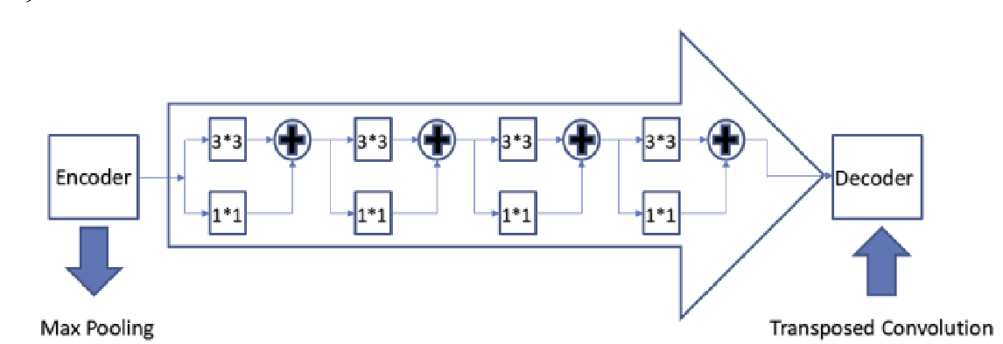
Part1 New idea: Skip connections
Using Respath as skip connection instead of identity.
In the ResPath the original features will be sent to two different convolutional layers.
More details can be accessed at https://arxiv.org/ftp/arxiv/papers/2006/2006.00414.pdf

Slide 4
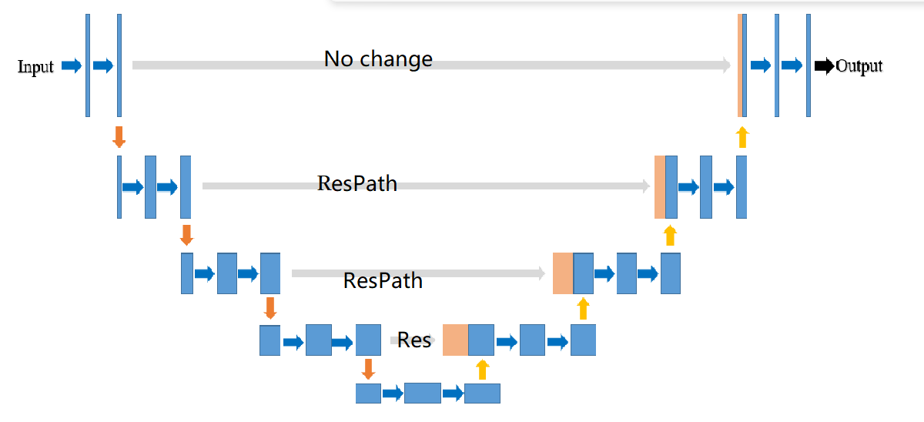
Part1 New idea: Skip connections
The side effect of the ResPath: leading to the loss of the original data, some features may be overextracted.
Our solution:
1. Adding the output to the original input
2. Applying the the ResPath at decoder 2,3,4

Slide 5
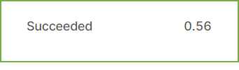
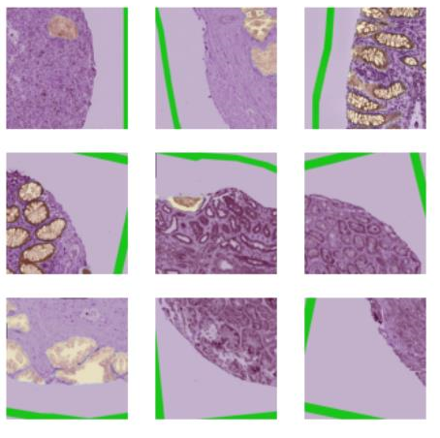
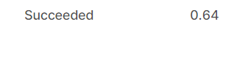
Part1: New idea: Effect of Vahadane stain Norm
The stain Normalization is designed to solve the problem of the imbalance of color in the picture
The final score is improved from 0.56 to 0.64

Slide 6
Part2: Summary of previous work (Overview)
Data Augmentation
Expansion
Loading the pretrained models
Using EfficientNet as the backbone of the model
Two different kinds of stain normalization
Ensemble learning
Balance of the dataset

Slide 7
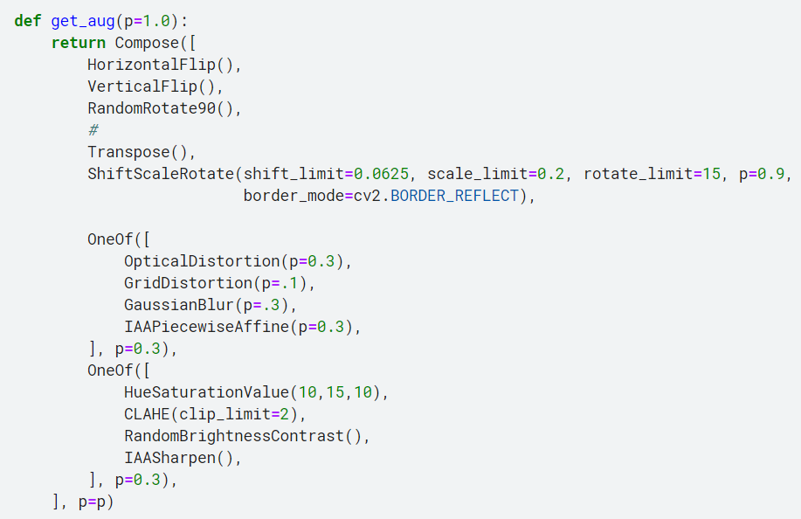
Part2: Summary of the precious work Data augmentation
Using data augmentation in the training process can significantly alleviate the problem of lack of data
After several tests, we have come up with a combination of data augmentation that maximise the score.
The final score has been improved to 0.61 from 0.56

Slide 8
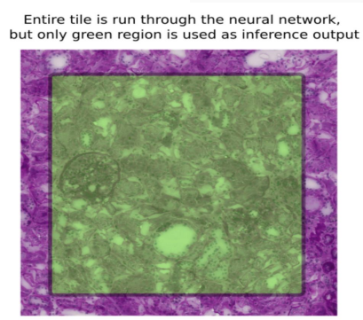
Part2: Summary of the previous work Expansion
The idea is to eliminate the edge effect of the prediction.
Process: Enlarge the tiles from four directions (the whole block), but only the centre region (green region) will be sent to the model for prediction.
The score is improved from 0.56 to 0.61

Slide 9
Part2: Summary of previous work (Loading the pretrained model)
Loading the parameters of the same model on a similar dataset allows the model to learn similar features on the dataset.
We loaded the model which is trained on the HuBMap kidney dataset
The score was improved from 0.56 to 0.61(without other methods)

Slide 10
Part2: Summary of previous work (Stain Normalization)
The aim of the stain normalization: Solving the problem of the imbalance of the hue
Four different kinds of stain Normalization: Stain-Net, Stain-GAN, Vahadane and Macenko methods.
Methods | Score (without stain is 0.56)
Vahadane | 0.64
Macenko | 0.61

Slide 11
Part2: Summary of previous work (Using the EfficientNet as backbone)
The efficient-net has many versions:B0, B1, B2, B3, B4, B5, B6 and B7
More details of the Efficient-Net can be accessed at EfficientNet: Rethinking Model Scaling for Convolutional Neural Networks (arxiv.org)
Backbone model | Score
Efficient-Net B5 | 0.66
Efficient-Net B7 | 0.68

Slide 12
Part2: Summary of previous work (Ensemble learning)
We combine different kinds of models together to calculate the average score of each pixel and get the value according to their output.
Combination of Base (score 0.56) and Effcient-Net B5 (score 0.66) is better than both of them and get a score of 0.69.

Slide 13
Part2: Summary of previous work (List of Results)
Trick | Score
Base | 0.56-
Base + Balance | 0.58↑
Base + pretrain | 0.61↑
Base + expansion | 0.61↑
Base + normalization(m) | 0.61↑
Base + augmentation | 0.61↑
Base + normalization(v) | 0.64↑
Base + ResPath | 0.64↑
Efficient-net(b5) | 0.67↑
Efficient-net(b7) | 0.68↑
Ensemble (b5+50) | 0.69↑
------------------------------------------------------------- | ----------------------
Base + expansion + augmentation | 0.63↑
Base + pertain + expansion + augmentation | 0.66↑
Base + petrain + expansion + augmentation + norm(v) | 0.67↑
Base + petrain + expansion + augmentation + balance | 0.67↑
Base + norm(v) + balance | 0.64↑
Efficient-net(b7) + expansion | 0.7↑
Efficient (b7) + expansion + balance | 0.7-
Efficient (b7) + expansion + norm(m) | 0.67↓
Efficient (b7) + expansion + norm(v) | 0.65↓
Effcient-B5 + Respath | 0.65↓

Slide 14
Part3: Future Plan Data preprocessing
We divide the whole dataset into two parts: the ones with color normalization and the ones without normalization.
Data augmentation strategies: We should design proper data augmentation strategies which are suitable for the data after stain normalization.
Changing the strategies of data augmentation.

Slide 15
Part3 Future Plan Improving decoders of the model
Most UNet variants (including UNet itself) have the same decoder block and encoder block, and they are also modified on the skip connection part.
Since the encoder part is fixed to a certain model (like ResNet), so we can work on finding the proper decoder block and skip connections to achieve a higher mark.

Slide 16
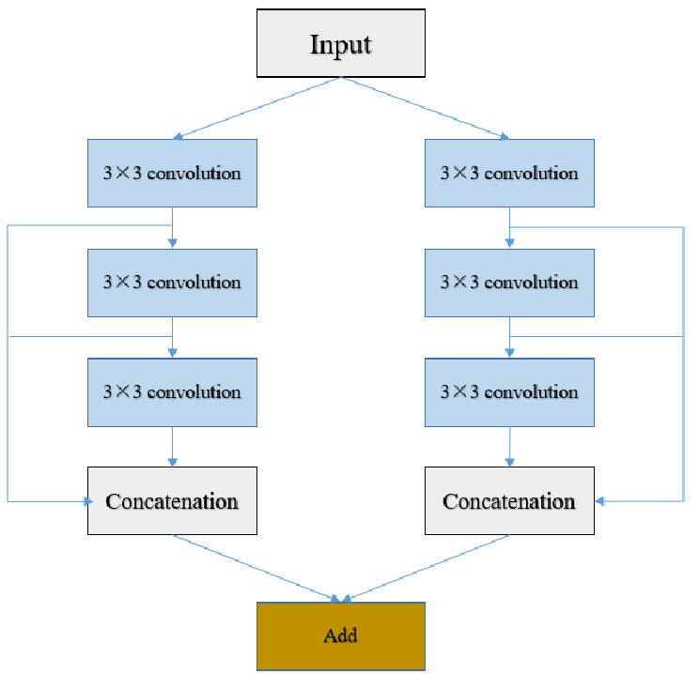
Part3: Future Plan Improving decoders of the model
DC-Block’s full name is Dual Channel Block. It has two channels for feature extraction.
Overcoming the problem of feature insufficiency.
More details can be accessed at https://arxiv.org/ftp/arxiv/papers/2006/2006.00414.pdf

Slide 17
Thank you!

